Slide 1

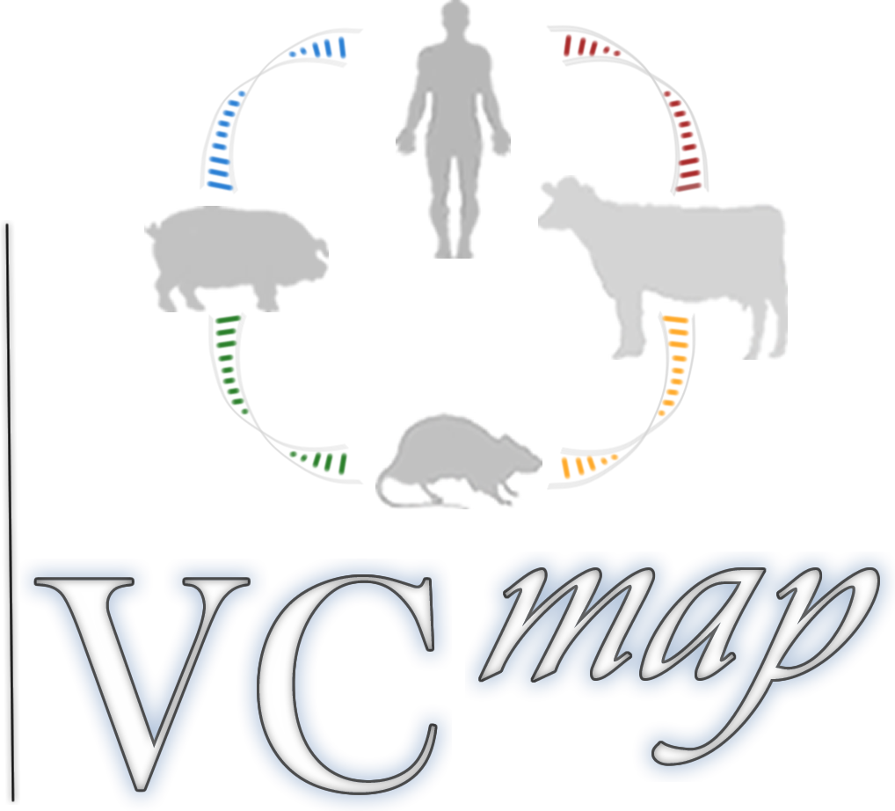

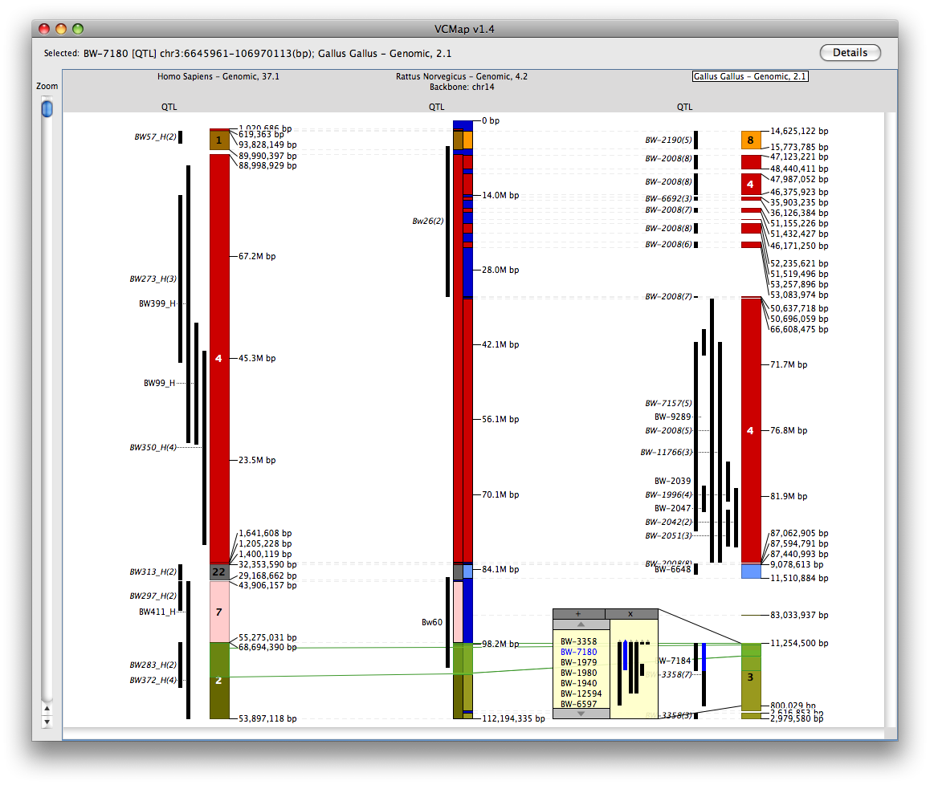
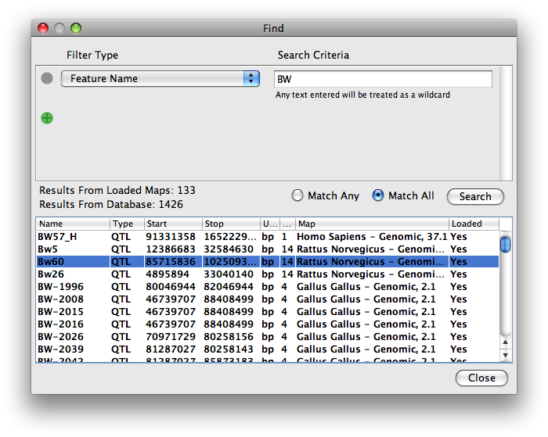
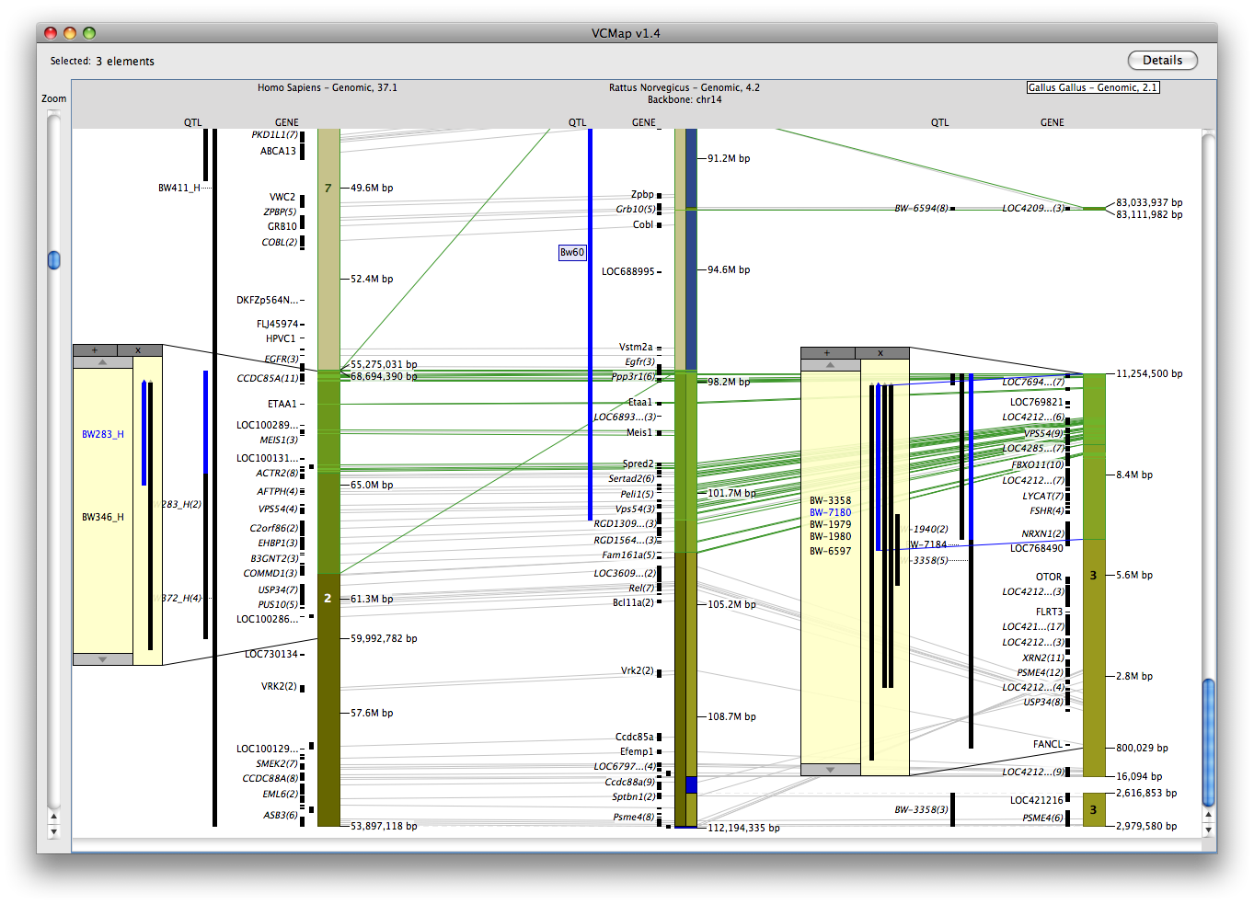
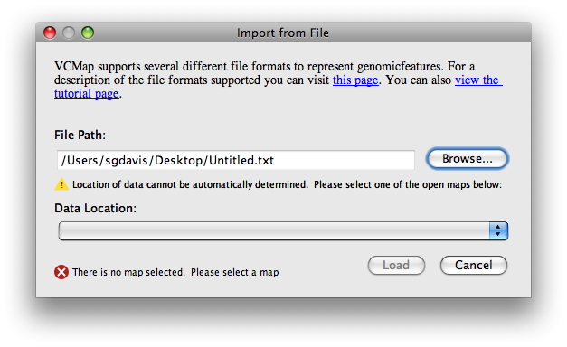
Virtual Comparative Mapping Tool (VCMap) 2.0,
a Comparative Genomics Tool
Davis SG¹, Koltes JE², Hu Z-L², Shimoyama M³, Dwinell M³, Reecy JM², Kwitek AE⁴
¹Bio::Neos, Inc., Coralville, IA, USA; ²Iowa State University, Ames, IA, USA; ³Medical College of Wisconsin, Milwaukee, WI, USA; ⁴Depts. of Pharmacology and Internal Medicine, University of Iowa, Iowa City, IA, USA
VCMap was a tool originally developed to visualize relationships of orthologous regions between the Rat, Mouse, and Human genomes and the associated annotation. This tool proved to be useful for many comparative genomics researchers, but it was not maintained after its completion in 2001.
In 2008, the tool was updated to improve the user interface and to expand the dataset to include the Cow, Pig, and Chicken genomes. The database for the tool contains an extensive set of quantitative trait loci (QTL) data for each of these species. This update made the system much more user friendly and intuitive, expanding the versatility and utility of the tool. This tool is a joint venture between researchers at The University of Iowa (UI), the Medical College of Wisconsin (MCW), and Iowa State University (ISU) and the software implementation is created by Bio::Neos, Inc and is freely available at:
http://vcmap.bioneos.com
This project is funded by USDA grant 2007-04187
Background
Macro View
In November of 2010, VCMap v2.0 was released. Version 2.0 builds additional features and improvements into the VCMap user interface along with performance improvements for an enhanced user experience. Additionally, the dataset for the tool has been updated to include more QTL data from MCW and ISU, additional map and annotation data from Ensembl, and updated data from NCBI.
Tutorial and Help System
VCMap 2.0 contains a help system with detailed information about how to navigate the user interface and manipulate the loaded data, as well as a tutorial that “walks” the user through using the system.
Image File Output
VCMap 2.0 allows for users to export the loaded data as an image complete with a customizable title and watermarked logo that can be placed arbitrarily on the image. The images can be output at screen resolution in either GIF, JPEG, BMP, or PNG format.
Enhanced Search Capabilities
VCMap 2.0 has improved search capabilities. The search dialog now has a more flexible set of filters and wildcards that can be used to search the loadable dataset. Additionally, the search feature is now able to query the database for any data available to be loaded and allows for quick loading of data directly from the search dialog.
Load Custom Data
One of the most useful features of VCMap 2.0 is the ability to load a custom annotation dataset onto a set of comparative maps. The system currently supports data in GFF3, SAM/BAM, and BED formats. This allows researchers to overlay their leading-edge data onto existing data in the system to enable comparative research, greatly increasing the extensibility of the system.
v2.0
Annotation
You can load features of several types, here we have loaded QTL features related to “Body Weight”. In version 2.0, you can even overlay your own custom annotation features on the comparative maps.
Connecting lines
The connecting lines visually represents homologous regions and homologous features. Green connecting lines represent approximate homologous regions. Gray connecting lines represent homologous annotation features, and turn Blue when those features are selected.
The first stable release of the redesigned VCMap has been named v1.0. It is a Java application that is launched via the Java WebStart technology for complete platform independence and a responsive user interface. The tool accesses a MySQL based relational database back-end in which map data and annotation has been gathered from several public data sources including NCBI, UCSC, and Ensembl as well as annotation data from the ISU's AnimalQTLdb and the Rat Genome Database at MCW.
The new interface is more responsive and utilizes improved feature grouping and rendering techniques to enable a usable interface at both the micro and macro levels. The following features are all included in v1.0 of the redesigned VCMap tool:
Backbone map
The tool enables comparative genomics with its unique user interface. The user designates a chromosome of a species as the “backbone” map. All other data that is loaded is then anchored onto this chromosome.
Comparative Maps (off-backbone)
This interface allows the user to load any number of additional maps from other species for comparison to each other and the backbone map. The off-backbone maps are aligned by a combination of NCBI's Homologene data, and the UCSC net conservation track.
Data Download
After using the VCMap interface to facilitate your examination of a region of interest, the tool allows a user to export the loaded data from a selected interval of the maps for comparison in an external spreadsheet application. The Data Download feature is highly customizable and allows the user to select what data is exported to best enable follow-up analysis.
v1.0
Comparative maps
You can load any number of maps to view comparatively side-by-side. Unlike the horizontally oriented view of traditional genome browser, this vertical view enables easy comparison from one map to another by scanning horizontally. Here we have loaded Rat chromosome 14 as a backbone map, and we are comparing it to the Human and Chicken genomic maps as comparative maps.
Popup window
The popup window enables you to investigate areas with many annotation features without having to zoom in the entire view. This facilitates an improved macro-view of the data. Here we have selected the BW-7180 QTL feature.
Custom Annotation
The systems supports loading multiple data annotation tracks, even custom annotations from your own GFF3, BED, or SAM/BAM formatted file. Here we have loaded QTL and Genes.
Zoom and Navigation
VCMap enables interrogation of specific regions of interest by zooming into smaller areas. Here we see a correlation between three selected ”Body Weight” related QTL annotations (BW283_H, Bw60, and BW-7180) on all three species. This correlation can be used to suggest additional features for follow-up analysis, and the resulting Gene dataset could be downloaded for examination in an external spreadsheet application.
Micro View

